Slide 1
Matrix Inversion

Slide 2
Applications of matrix inversion :
Games and Animation
Electronic Transport Theory
Encoding and Decoding

Slide 3
Different ways of Matrix inversion
Gauss-Jordan elimination
LU decomposition
QR decomposition

Slide 4
Gauss Jordan Method
Given a n x n matrix A,determine the inverse of the matrix denoted by A ⁻¹
A x B = B x A = I_{n} => B = A⁻¹
Elementary Row Operations:
Interchange distinct rows of A
Multiply a row of A by a non zero constant c ≠ 0
Add a constant multiple of row i to row j , where i ≠ j
We know that if a sequence σ of such operations applied to A transforms it into I_{n} then the same sequence σ applied to I_{n} transforms it into A⁻¹ .
Thus, we can find A⁻¹ by finding such a sequence σ that transforms the augmented matrix
[ A | I_{n} ] to [ I_{n} | A⁻¹ ]

Slide 5
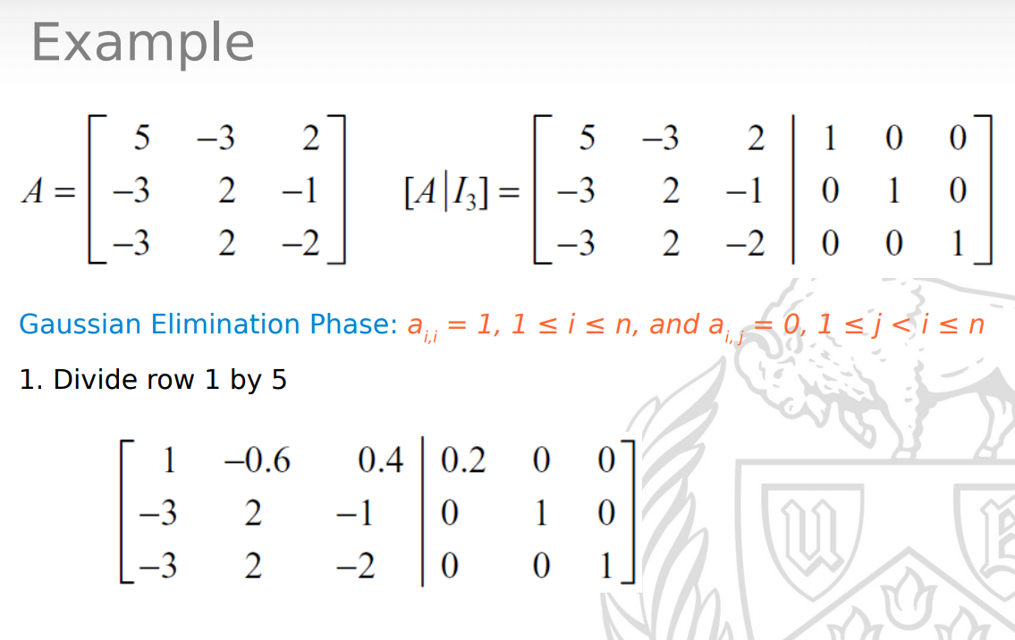
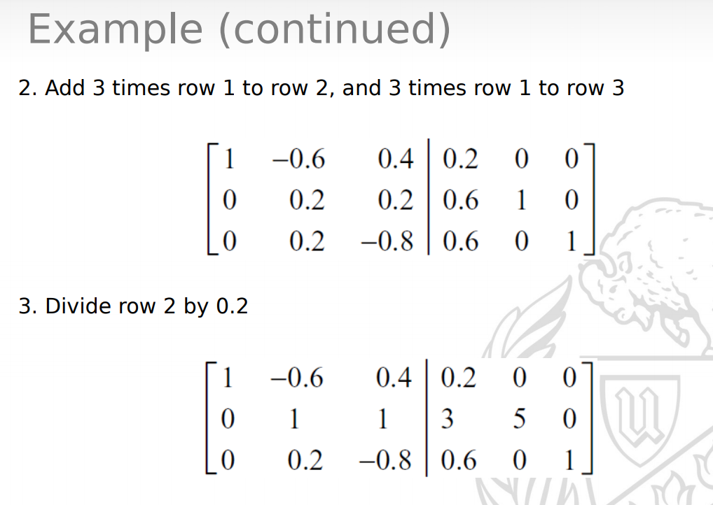
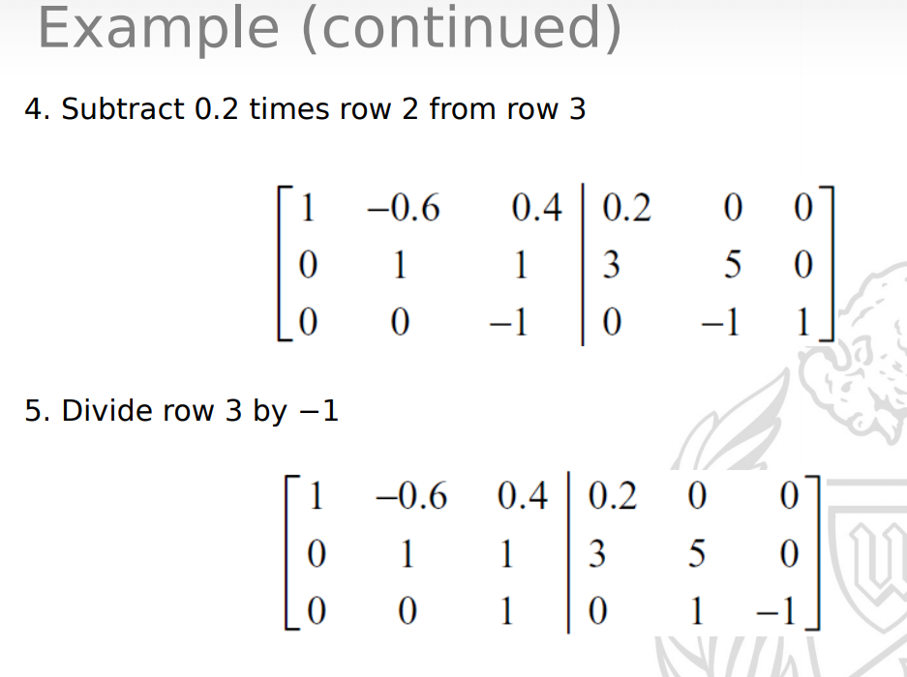
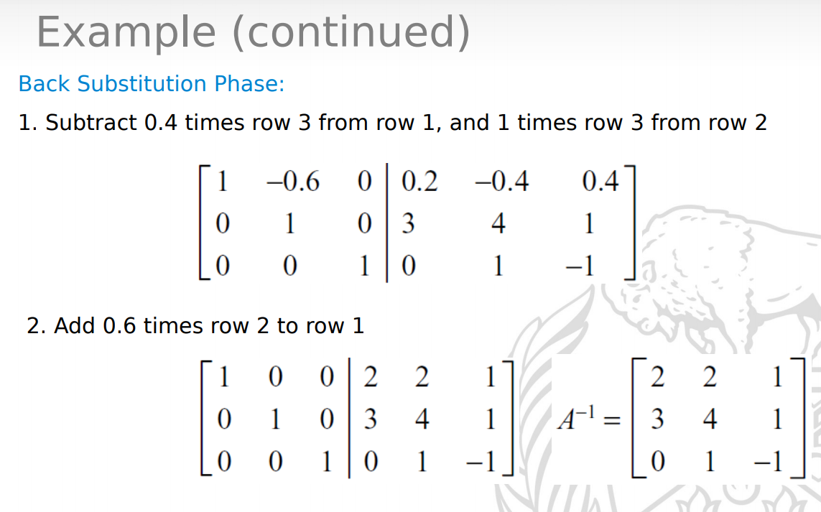

Slide 6




L U Decomposition
STEP1
STEP2
STEP3

Slide 7
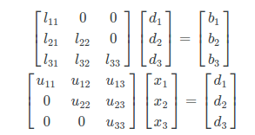
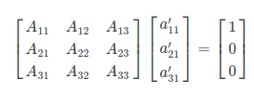
STEP4
INVERSION USING LU DECOMPOSITION
STEP1
STEP2

Slide 8
Gauss Jordan Method

Slide 9
INITIAL ALGORITHM WITH LOCKS
level=-1; size_count=row_size;
void diagonal(int column,int row){
Perform matrix operation on input matrix to make a[row][column]=0;
Apply same operations on a identity matrix b[][];
pthread_mutex_lock(&lock1);
size-count-- ;
pthread_mutex_unlock(&lock1);}
void * Writer(void* thread_Id){
for column in range (0 to column_size ) {
for row in range (thread_Id to row_size) incremented by number of threads { diagonal(column,row); }
while(size_count >0){ // wait for all threads to finish a column
if(level==column){
break;}}
pthread_mutex_lock(&lock1);
if (size_count<1) { //exit all the threads from the loop using broke
size_count = row_size;
level=column;}
pthread_mutex_unlock(&lock1);}}

Slide 10
ALGORITHM WITHOUT LOCKS
atomic <int> size_count,level; level=-1; size_count=row_size;
void diagonal(int column,int row){
Perform matrix operation on input matrix to make a[row][column]=0;
Apply same operations on a identity matrix b[][];
size-count-- ; }
void * Writer(void* thread_Id){
for column in range (0 to column_size ) {
for row in range (thread_Id to row_size) incremented by number of threads {
diagonal(column,row); }
while(size_count >0){ // wait for all threads to finish a column
if(level==column){
break; }}
if (size_count<1) { //exit all the threads from the loop using broke
size_count = row_size;
level=column; } } }
Notes:
Reference : https://docs.google.com/document/d/13sXHu_bx9qySZ09KI3Ewu0YuncPJt4PGEJwttExaayE/edit?ts=5b175f37

Slide 11
Idea of maintaining a array for levels
initial
[0,0,0,0,0,0,......]
After all threads finish a level
[1,0,0,0,0,.......]
But to check if all threads finished a level u need to keep a count and that condition will not be atomic so which makes it a critical section

Slide 12
FINAL ALGORITHM
atomic <int> level_quantity,level;
void diagonal(int column,int row){
Perform matrix operation on input matrix to make a[row][column]=0;
Apply same operations on a identity matrix b[][];}
void * Writer(void* thread_Id){
for column in range (0 to column_size ) {
if(!(column==0)){
while(!(level_quantity==column*thread_size)){
if(column<level)
break;}}
level=column+1;
for row in range (thread_Id to row_size) incremented by number of threads {
diagonal(column,row);
}
level_quantity++;}

Slide 13
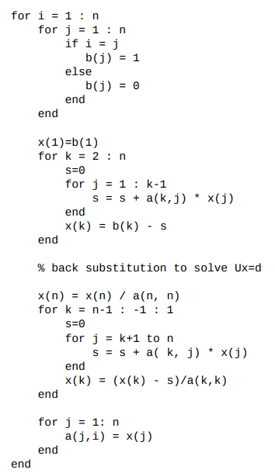
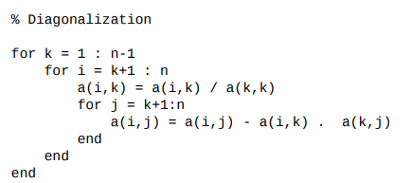
LU Decomposition

Slide 14
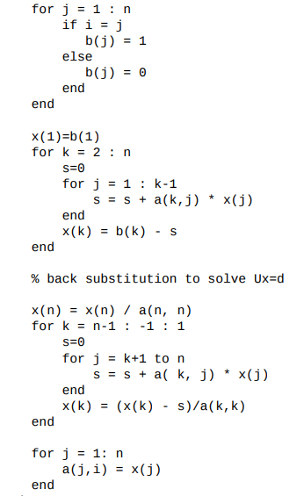
LU Decomposition parallelization
Each thread runs this code :

Slide 15
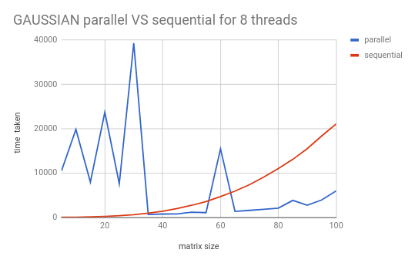
Results - Gaussian parallel vs sequential

Slide 16
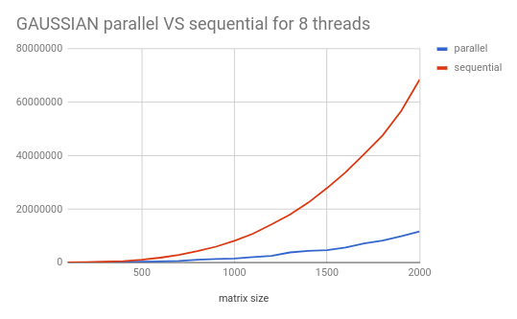
Results - Gaussian parallel vs sequential

Slide 17
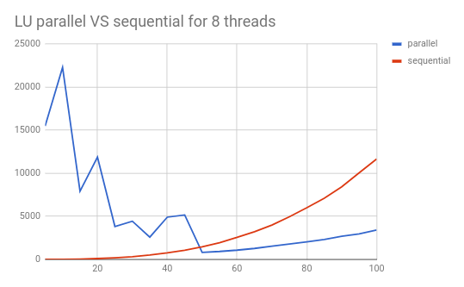
Results - LU parallel vs sequential

Slide 18
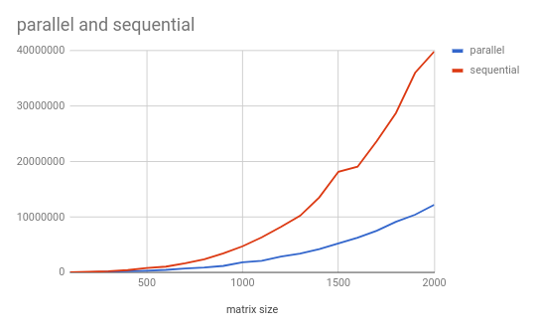
Results - LU parallel vs sequential

Slide 19
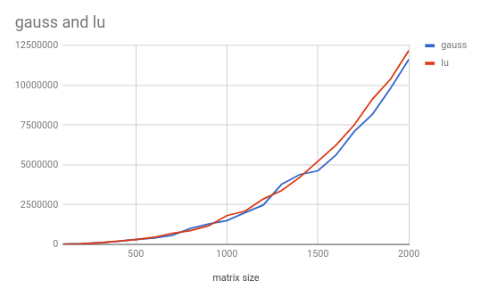
Gaussian parallel vs LU parallel

Slide 20
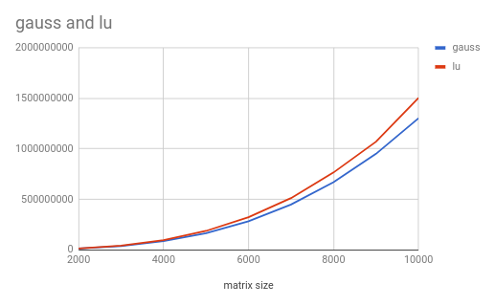
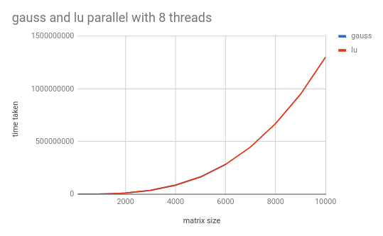
Gaussian parallel vs LU parallel

Slide 21
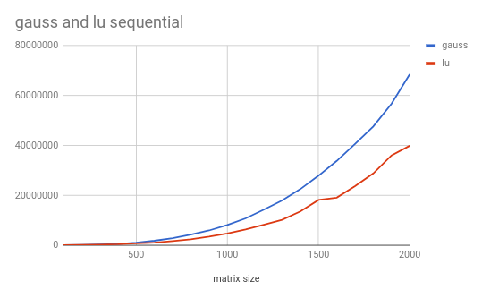
Gaussian sequential vs LU sequential

Slide 22
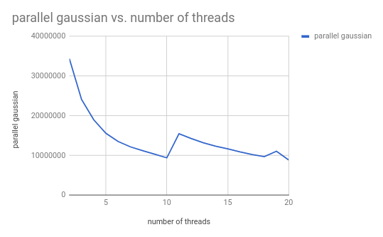
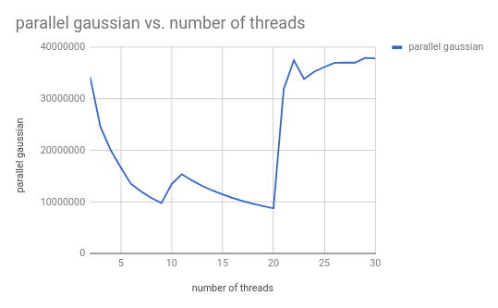
Gaussian parallel vs no. of threads

Slide 23
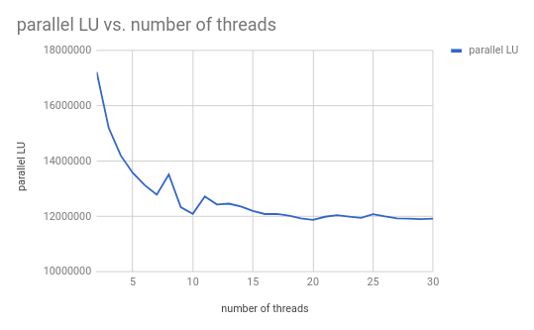
Parallel LU vs no.of threads

Slide 24
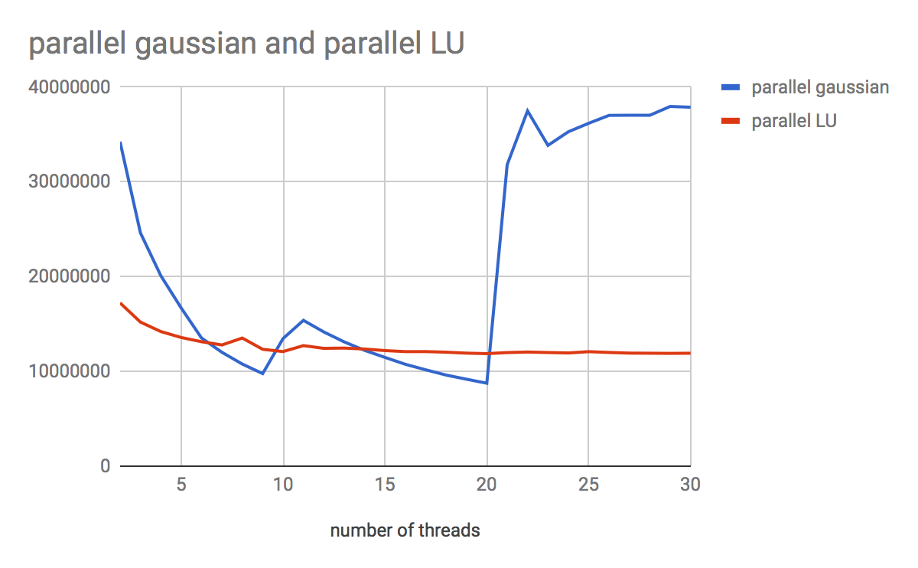
Gaussian parallel vs LU parallel

